Slide 1
Encyclopedia
of Quantitative
Methods in R
Vol. 1 – WRANGLING
Office of Research Services
College of Education and Human Services
Utah State University
Vol. 2 – EXPLORATORY
Vol. 3 – ANOVA
Vol. 4 – REGRESSION
Vol. 5 – MULTILEVEL
Vol. 6 – SEM
Vol. 0 – SOFTWARE
Vol. 7 – OTHER
- Sarah Schwartz & Tyson Barrett -

Slide 2
Encyclopedia
of Quantitative
Methods in R
Vol. 0 – SOFTWARE
Office of Research Services
College of Education and Human Services
Utah State University
Vol. 1 – WRANGLING
Vol. 2 – EXPLORATORY
Vol. 3 – ANOVA
Vol. 4 – REGRESSION
Vol. 5 – MULTILEVEL
Vol. 6 – SEM
- Sarah Schwartz & Tyson Barrett -
Vol. 7 – OTHER

Slide 3
Encyclopedia
of Quantitative
Methods in R
Vol. 1 – WRANGLING
Office of Research Services
College of Education and Human Services
Utah State University
Vol. 2 – EXPLORATORY
Vol. 3 – ANOVA
Vol. 4 – REGRESSION
Vol. 5 – MULTILEVEL
Vol. 6 – SEM
Vol. 0 – SOFTWARE
Vol. 7 – OTHER
- Sarah Schwartz & Tyson Barrett -

Slide 4
Encyclopedia
of Quantitative
Methods in R
Vol. 2 – EXPLORATORY
Office of Research Services
College of Education and Human Services
Utah State University
Vol. 1 – WRANGLING
Vol. 3 – ANOVA
Vol. 4 – REGRESSION
Vol. 5 – MULTILEVEL
Vol. 6 – SEM
Vol. 0 – SOFTWARE
Vol. 7 – OTHER
- Sarah Schwartz & Tyson Barrett -

Slide 5
Encyclopedia
of Quantitative
Methods in R
Vol. 3 – ANOVA
Office of Research Services
College of Education and Human Services
Utah State University
Vol. 1 – WRANGLING
Vol. 2 – EXPLORATORY
Vol. 4 – REGRESSION
Vol. 5 – MULTILEVEL
Vol. 6 – SEM
Vol. 0 – SOFTWARE
Vol. 7 – OTHER
- Sarah Schwartz & Tyson Barrett -

Slide 6
Encyclopedia
of Quantitative
Methods in R
Vol. 4 – REGRESSION
Office of Research Services
College of Education and Human Services
Utah State University
Vol. 5 – MULTILEVEL
Vol. 6 – SEM
Vol. 1 – WRANGLING
Vol. 7 – OTHER
Vol. 2 – EXPLORATORY
Vol. 0 – SOFTWARE
Vol. 3 – ANOVA
- Sarah Schwartz & Tyson Barrett -

Slide 7
Encyclopedia
of Quantitative
Methods in R
Vol. 5 – MULTILEVEL
Office of Research Services
College of Education and Human Services
Utah State University
Vol. 6 – SEM
Vol. 1 – WRANGLING
Vol. 7 – OTHER
Vol. 2 – EXPLORATORY
Vol. 3 – ANOVA
Vol. 0 – SOFTWARE
Vol. 4 – REGRESSION
- Sarah Schwartz & Tyson Barrett -

Slide 8
Encyclopedia
of Quantitative
Methods in R
Office of Research Services
College of Education and Human Services
Utah State University
Vol. 6 – SEM
Vol. 1 – WRANGLING
Vol. 7 – OTHER
Vol. 2 – EXPLORATORY
Vol. 3 – ANOVA
Vol. 4 – REGRESSION
Vol. 0 – SOFTWARE
Vol. 5 – MULTILEVEL
- Sarah Schwartz & Tyson Barrett -

Slide 9
Encyclopedia
of Quantitative
Methods in R
Office of Research Services
College of Education and Human Services
Utah State University
Vol. 1 – WRANGLING
Vol. 7 – OTHER
Vol. 2 – EXPLORATORY
Vol. 3 – ANOVA
Vol. 4 – REGRESSION
Vol. 5 – MULTILEVEL
Vol. 0 – SOFTWARE
Vol. 6 – SEM
- Sarah Schwartz & Tyson Barrett -

Slide 10
Vol. 0 – SOFTWARE
Vol. 1 – WRANGLING
Vol. 2 – EXPLORATORY
Vol. 3 – ANOVA
Vol. 4 – REGRESSION
Vol. 5 – MULTILEVEL
Vol. 6 – SEM
Vol. 7 – OTHER

Slide 12
Office of Research Services
College of Education and Human Services, Utah State University
Encyclopedia
of Quantitative
Methods in R
Vol. 1 – WRANGLING
Vol. 2 – EXPLORATORY
Vol. 3 – ANOVA
Vol. 4 – REGRESSION
Vol. 5 – MULTILEVEL
Vol. 6 – SEM
Vol. 0 – SOFTWARE
Vol. 7 – OTHER
Sarah Schwartz
Tyson Barrett

Slide 13
Setting up Your Computer
Installing R, R Studio, and Packages
Encyclopedia
of Quantitative
Methods in R
Vol. 0 – SOFTWARE
Vol. 1 – WRANGLING
Vol. 3 – ANOVA
Vol. 4 – REGRESSION
Vol. 5 – MULTILEVEL
Vol. 6 – SEM
Vol. 2 – EXPLORATORY
Vol. 7 – OTHER
Sarah Schwartz
Tyson Barrett

Slide 14
Data Management
Importing, Sub-Setting, Creating Variables, and Saving
Encyclopedia
of Quantitative
Methods in R
Vol. 1 – WRANGLING
Vol. 2 – EXPLORATORY
Vol. 3 – ANOVA
Vol. 4 – REGRESSION
Vol. 5 – MULTILEVEL
Vol. 6 – SEM
Vol. 0 – SOFTWARE
Vol. 7 – OTHER
Sarah Schwartz
Tyson Barrett

Slide 15
Exploratory Data Analysis
Summary Statistics and Descriptive Visualizations
Encyclopedia
of Quantitative
Methods in R
Vol. 2 – EXPLORATORY
Vol. 3 – ANOVA
Vol. 4 – REGRESSION
Vol. 5 – MULTILEVEL
Vol. 6 – SEM
Vol. 0 – SOFTWARE
Vol. 7 – OTHER
Vol. 1 – WRANGLING
Sarah Schwartz
Tyson Barrett

Slide 16
Testing Mean Differences
t-tests, ANOVA, RM ANOVA, and post hoc tests
Encyclopedia
of Quantitative
Methods in R
Vol. 3 – ANOVA
Vol. 4 – REGRESSION
Vol. 5 – MULTILEVEL
Vol. 6 – SEM
Vol. 0 – SOFTWARE
Vol. 7 – OTHER
Vol. 1 – WRANGLING
Vol. 2 – EXPLORATORY
Sarah Schwartz
Tyson Barrett

Slide 17
Multiple Linear Regression
Correlation, Model Fit, Generalize, and Plot
Encyclopedia
of Quantitative
Methods in R
Vol. 4 – REGRESSION
Vol. 5 – MULTILEVEL
Vol. 6 – SEM
Vol. 2 – EXPLORATORY
Vol. 7 – OTHER
Vol. 0 – SOFTWARE
Vol. 3 – ANOVA
Vol. 1 – WRANGLING
Sarah Schwartz
Tyson Barrett

Slide 18
Multilevel Models: RM Regression
ICCs, MLM/HLM, and GEEs
Encyclopedia
of Quantitative
Methods in R
Vol. 5 – MULTILEVEL
Vol. 6 – SEM
Vol. 2 – EXPLORATORY
Vol. 4 – REGRESSION
Vol. 7 – OTHER
Vol. 0 – SOFTWARE
Vol. 3 – ANOVA
Vol. 1 – WRANGLING
Sarah Schwartz
Tyson Barrett

Slide 19
Structural Equation Modeling
EFA, CFA, Path Analysis, and SEM
Encyclopedia
of Quantitative
Methods in R
Vol. 6 – SEM
Vol. 4 – REGRESSION
Vol. 7 – OTHER
Vol. 2 – EXPLORATORY
Vol. 5 – MULTILEVEL
Vol. 0 – SOFTWARE
Vol. 3 – ANOVA
Vol. 1 – WRANGLING
Sarah Schwartz
Tyson Barrett

Slide 20
Additional Topics
Room for Future Expansion
Encyclopedia
of Quantitative
Methods in R
Vol. 7 – OTHER
Vol. 4 – REGRESSION
Vol. 5 – MULTILEVEL
Vol. 2 – EXPLORATORY
Vol. 6 – SEM
Vol. 0 – SOFTWARE
Vol. 3 – ANOVA
Vol. 1 – WRANGLING
Sarah Schwartz
Tyson Barrett

Slide 21

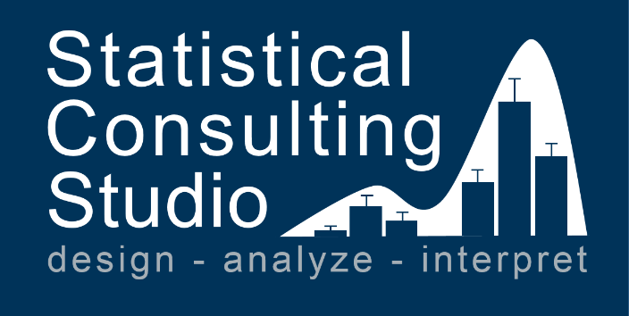


Slide 22







Slide 23




Slide 24
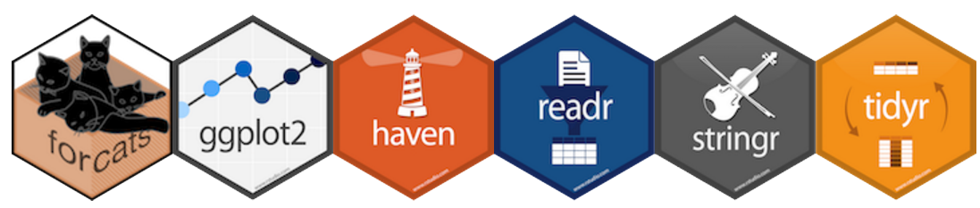
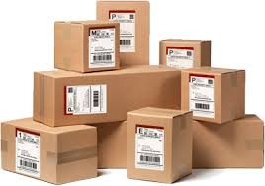




Slide 25




Slide 26





Slide 27



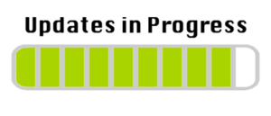

Slide 28

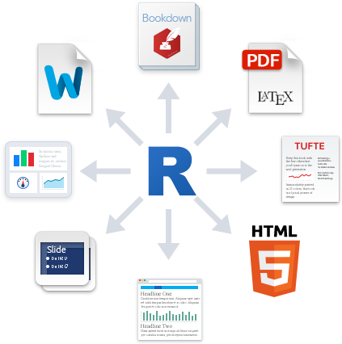





Input Data Files
.xlsx
.sav
.cvs
R Notebook (.Rmd)
Output Files
.html
.docx
.pdf
YAML header
Plain Text
R Code Chunk
R output
Plain Text
R Code Chunk
R output

Slide 29

YAML header
YAML header
Plain Text
R Code Chunk
Plain Text
R output
R Code Chunk
Plain Text
R output
Plain Text
R Code Chunk
R output
R Code Chunk
R output

Slide 30
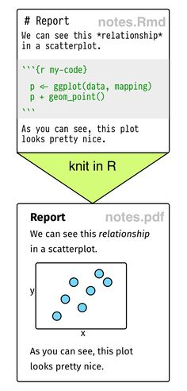
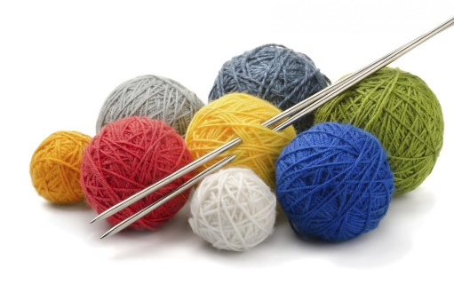

Slide 31
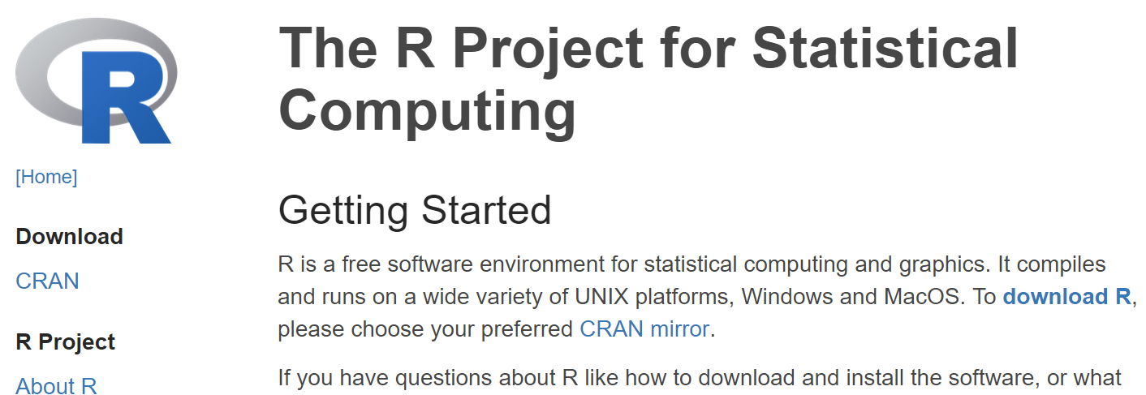
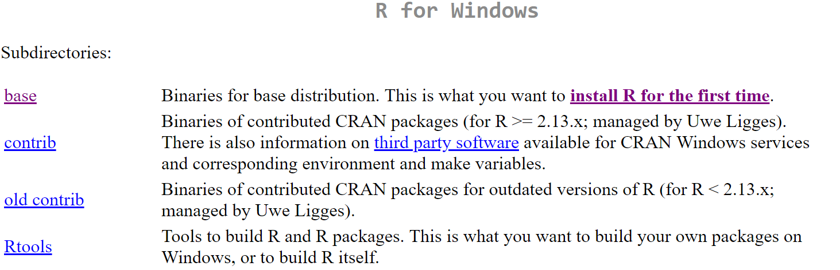
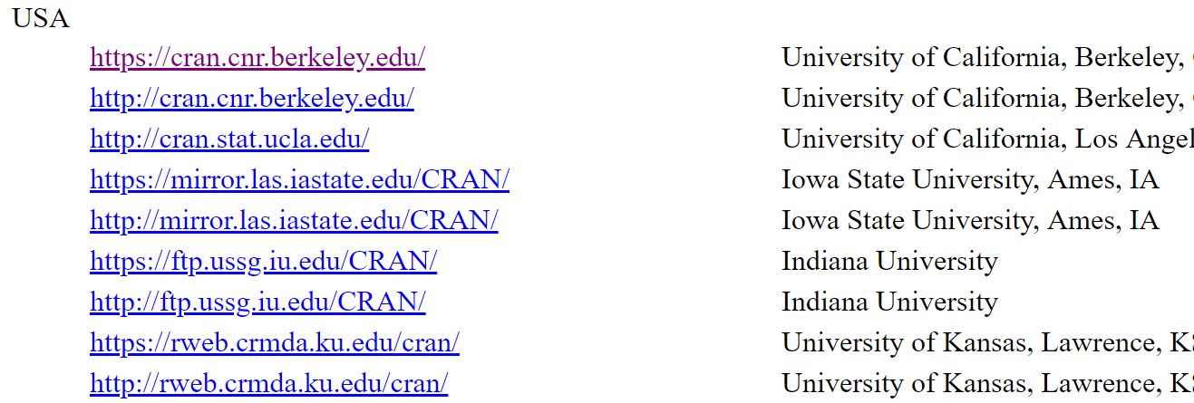
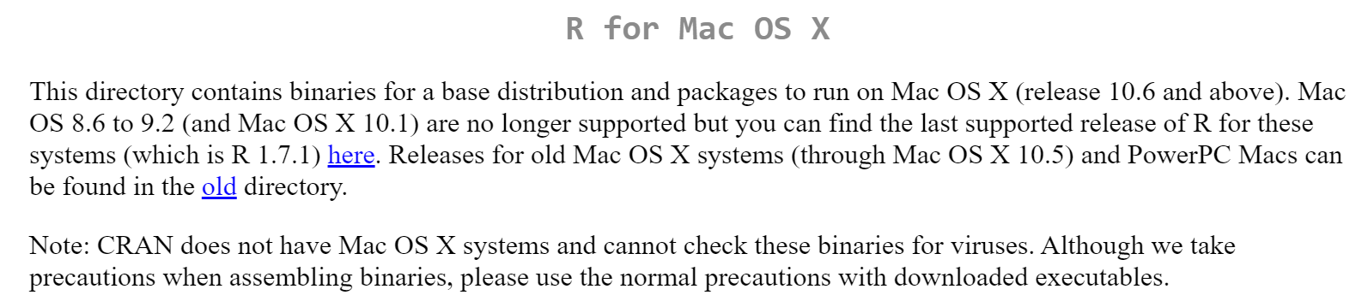
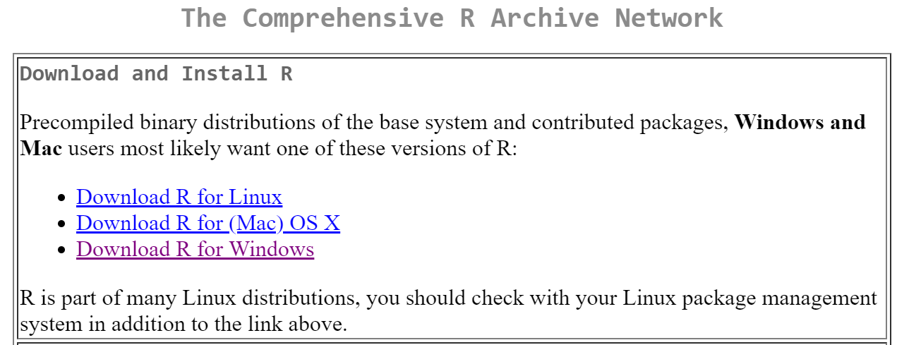
4.
1.
click “download R”
2.
Scroll to
Somewhere
Close to you
3. Select your platform

Slide 32
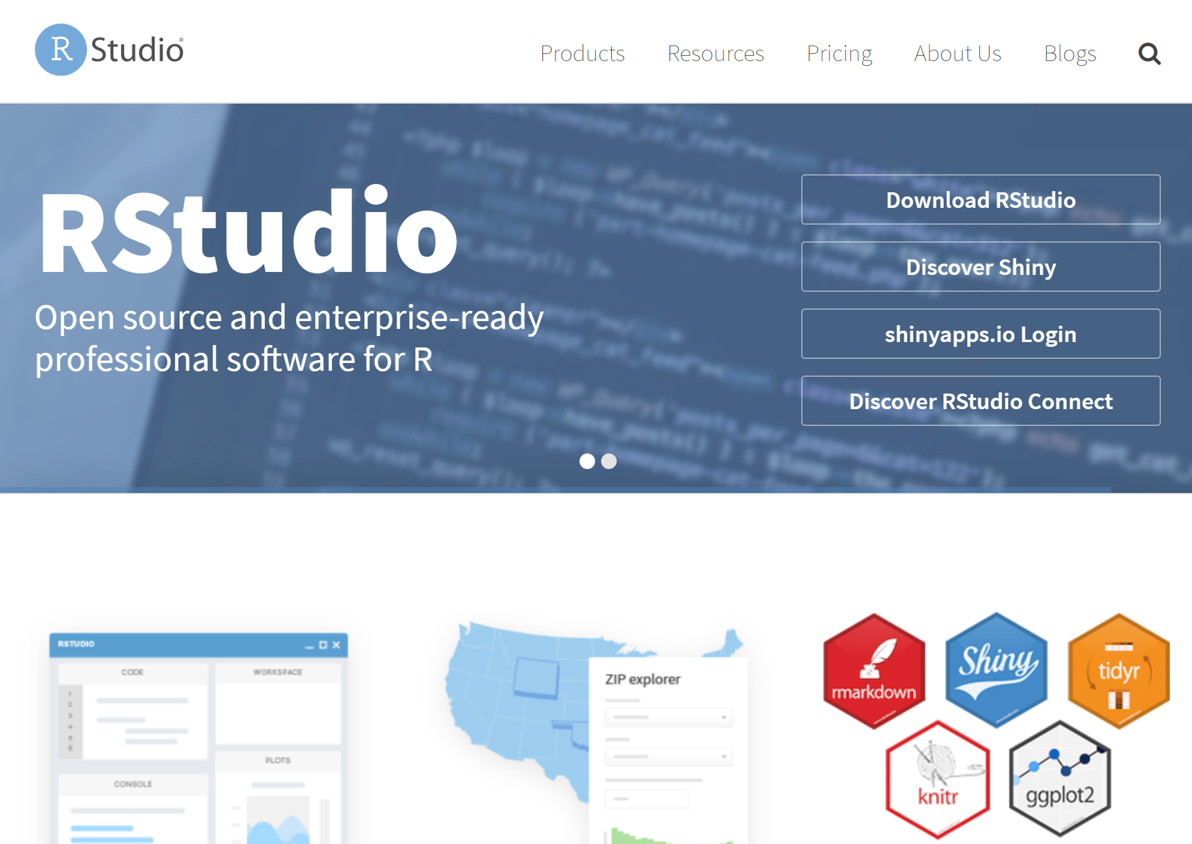
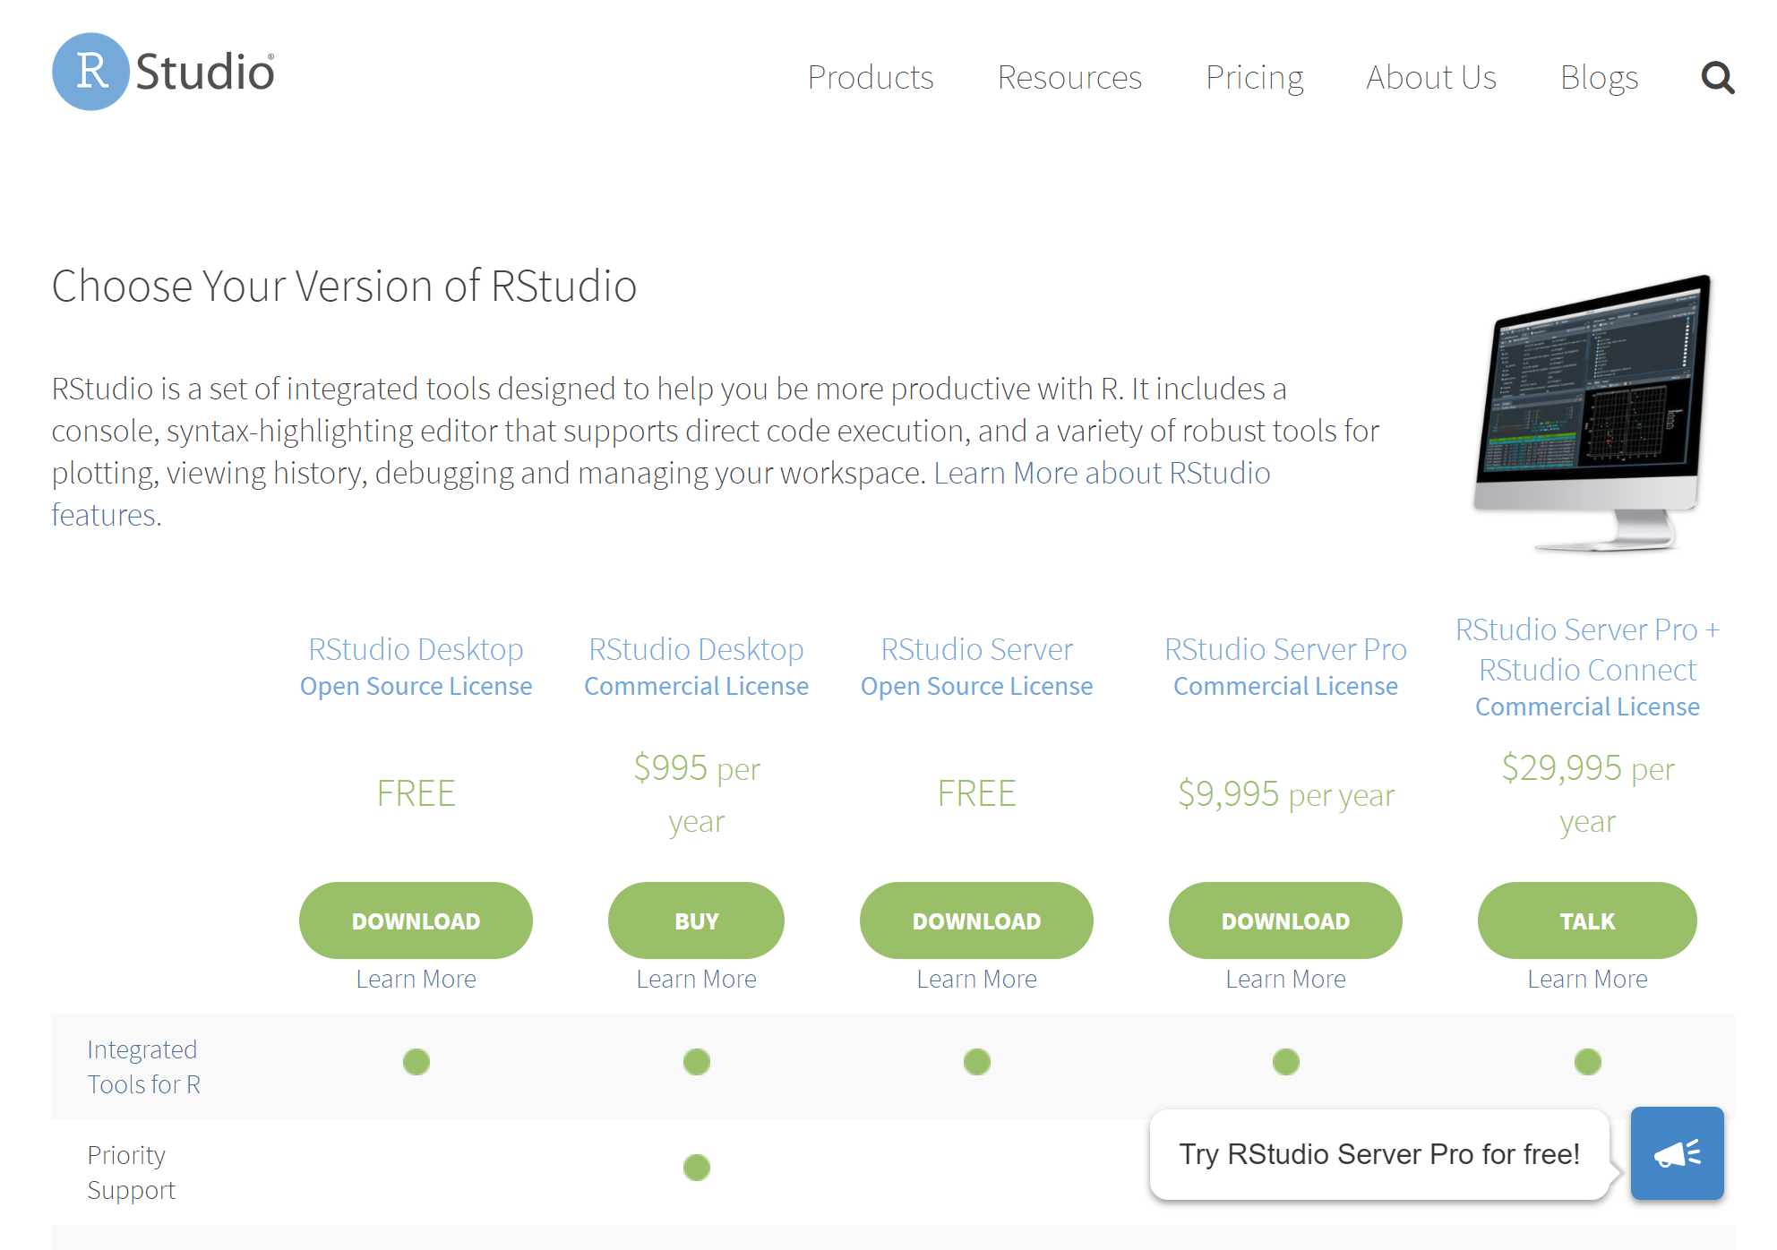
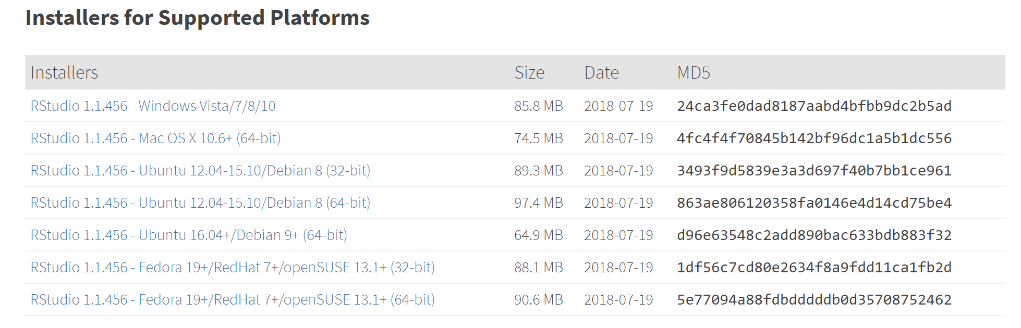
1. click
2. Select the
Free desktop version
3. Select your platform

Slide 33
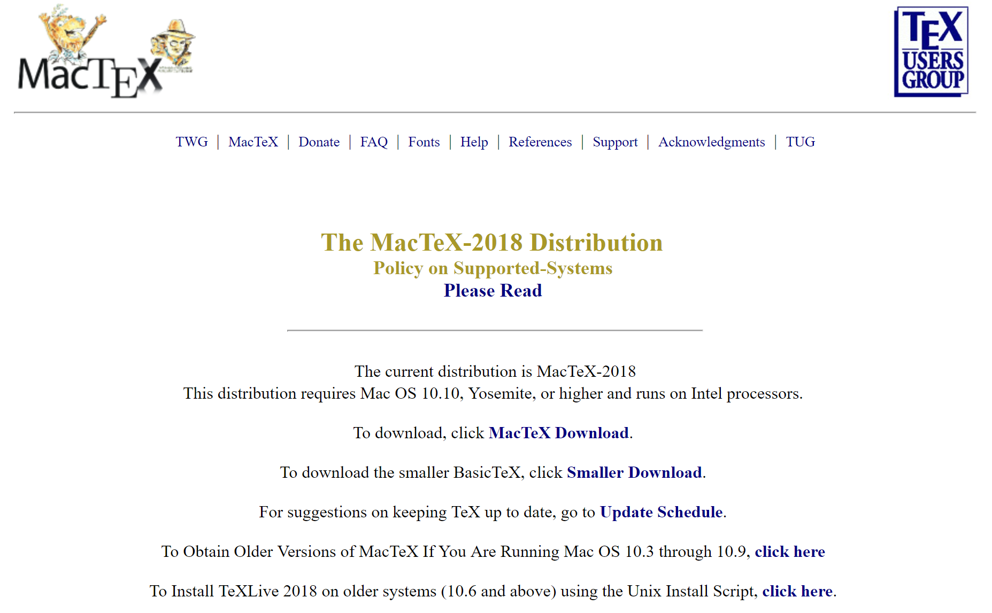

Slide 34
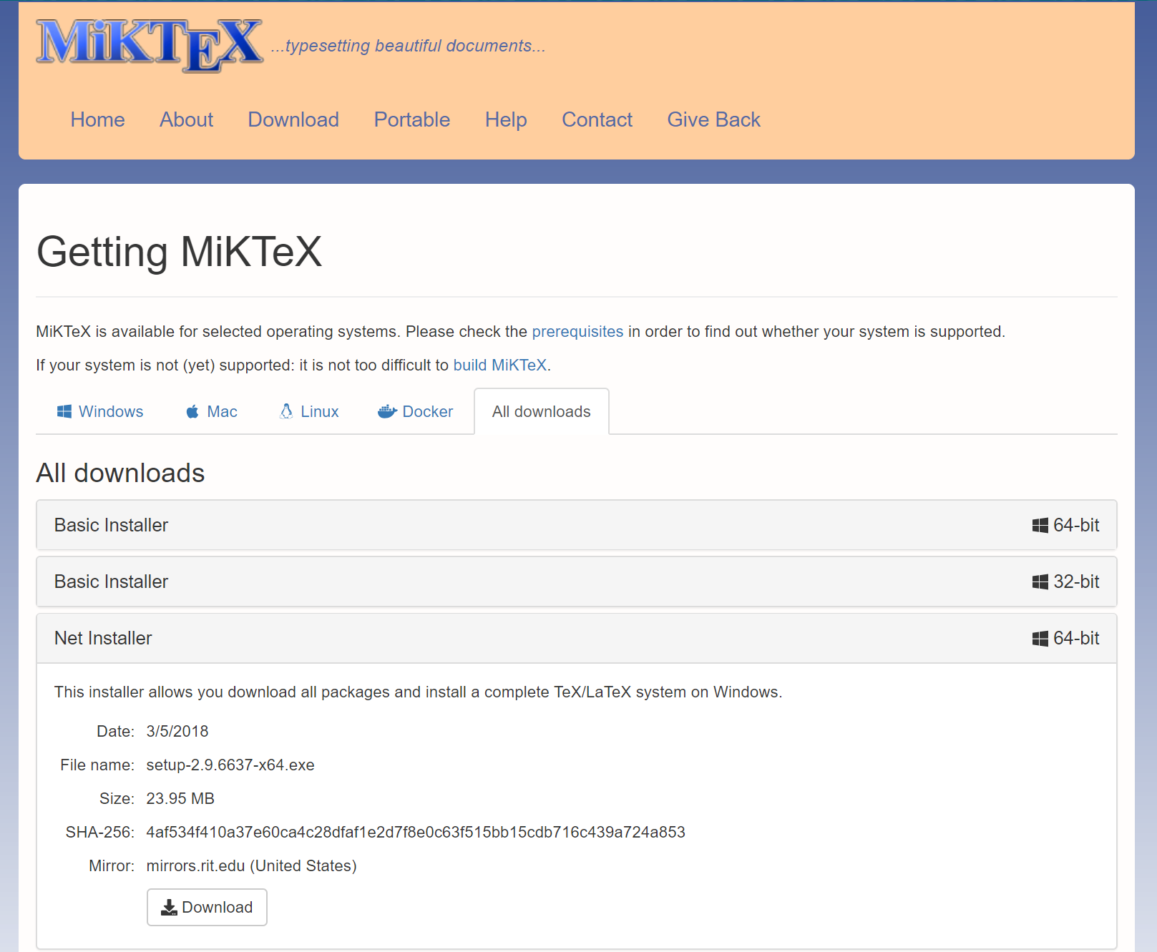

Slide 35
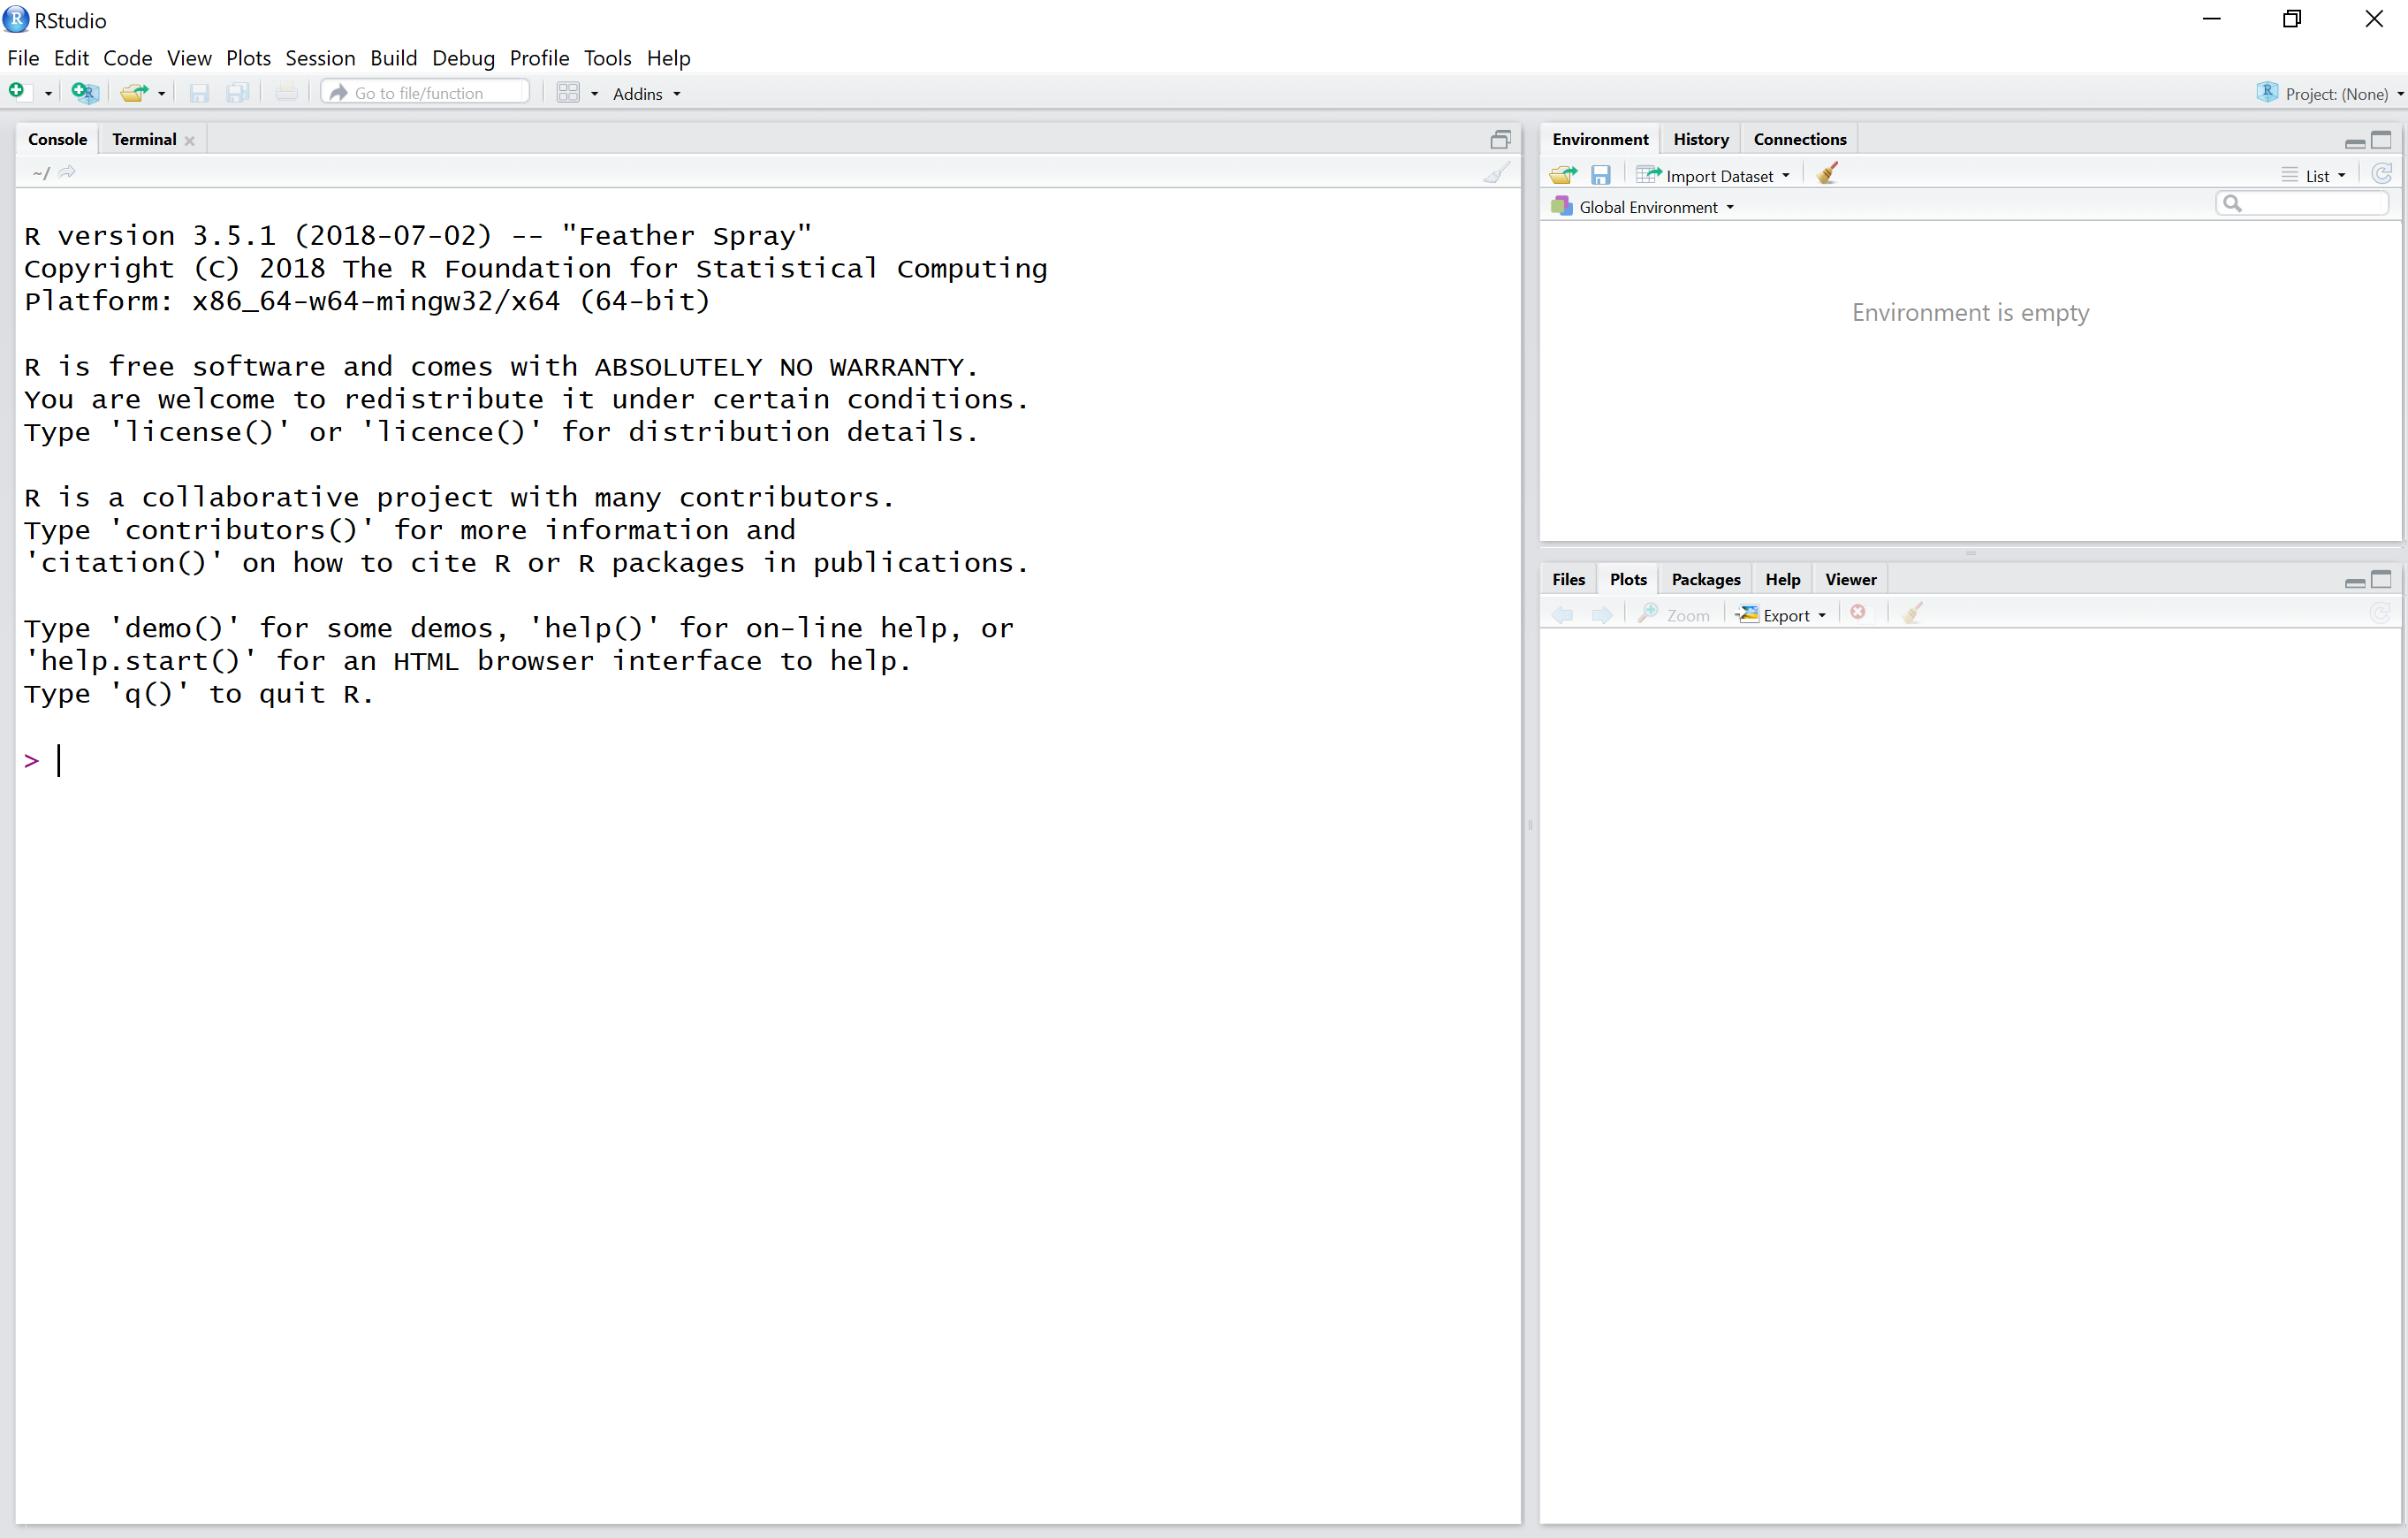
Default Arrangement
Environment Tab
Few-Tabs Panel
Tells you which version of R you are using
Help Tab
Packages Tab
Files Tab
Console Panel
Many-Tabs Panel

Slide 36
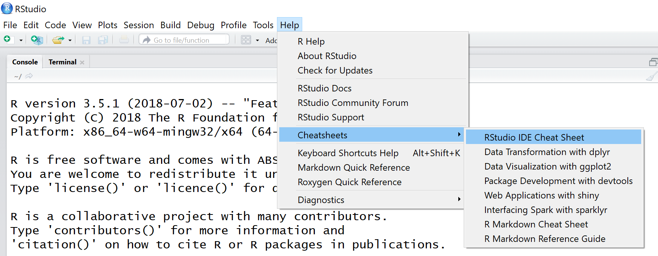
Cheatsheets

Slide 37
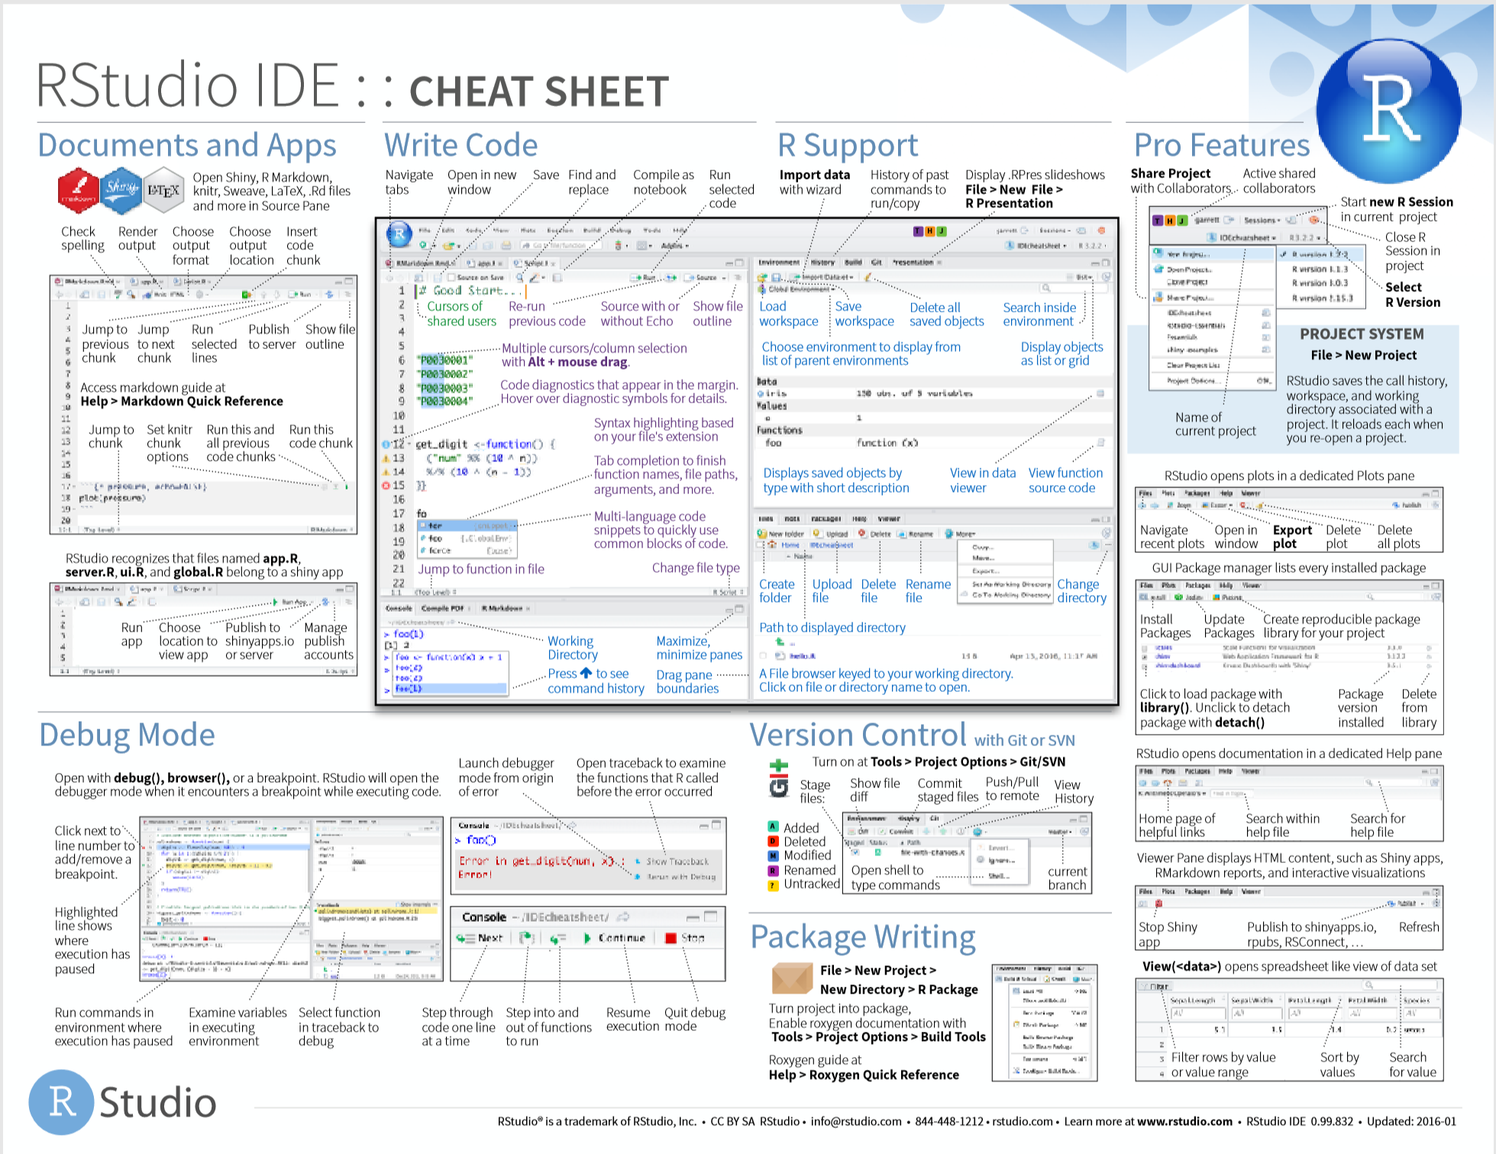

Slide 39
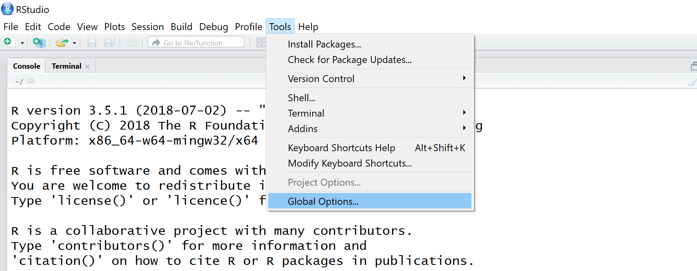
Global Options

Slide 40
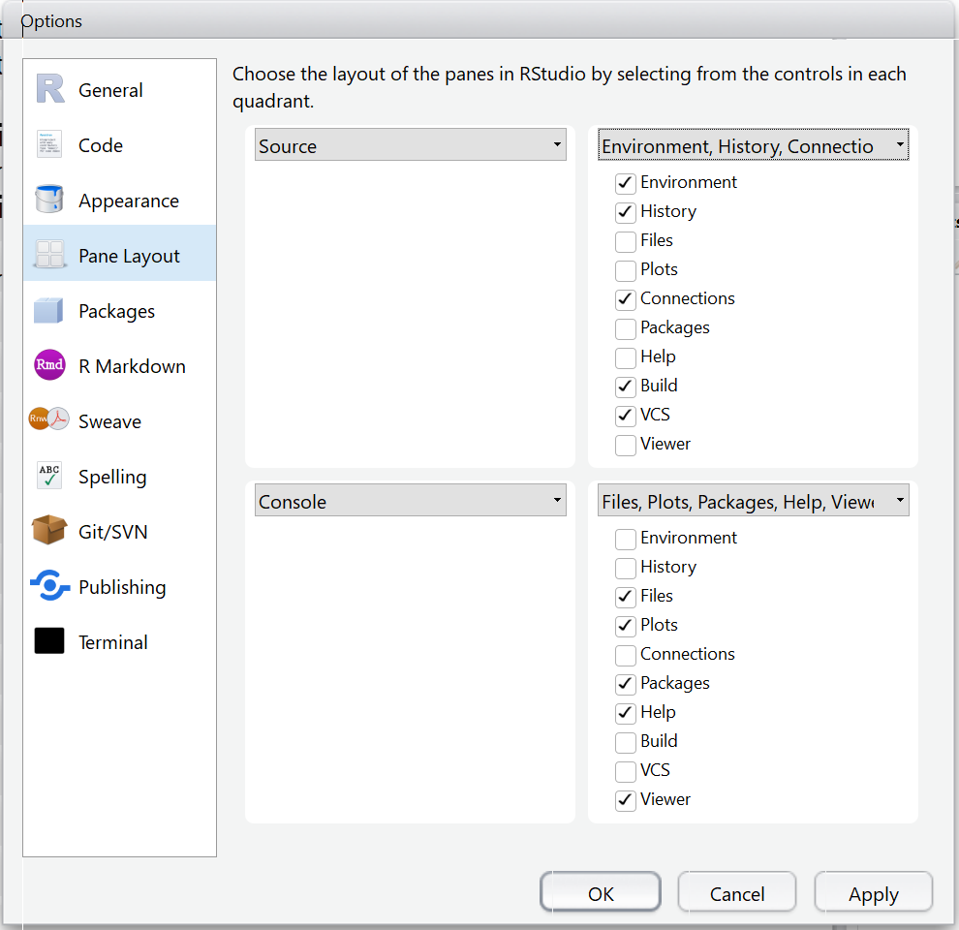
Global Options
swap

Slide 41
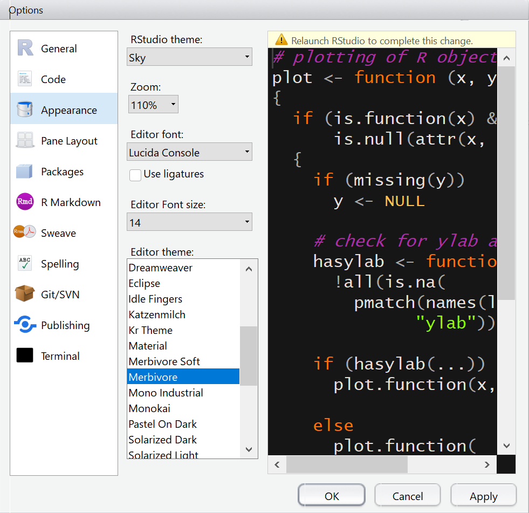
Global Options

Slide 42
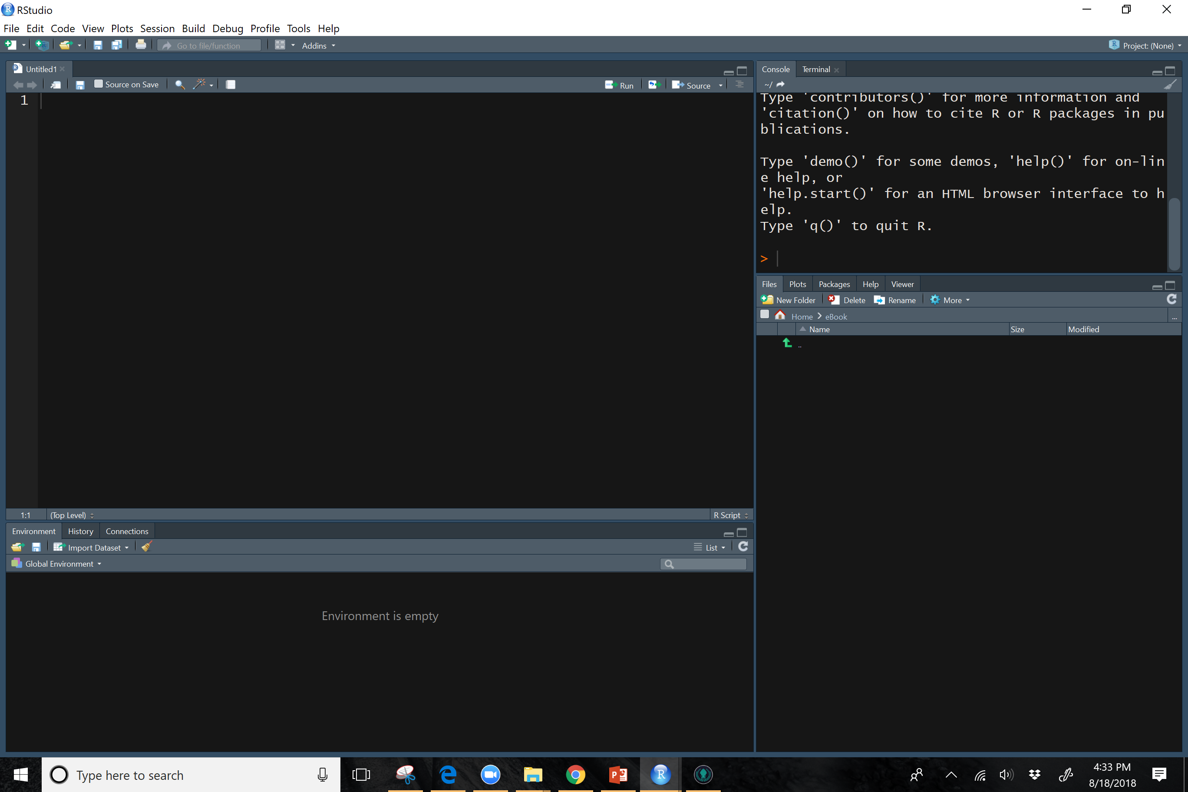
Sarah’s Favorite Arrangement
Console Panel
R Notebook
Help Tab
Packages Tab
Files Tab
Environment Tab
Many-Tabs Panel
Few-Tabs Panel

